Slide 1

Labyrinth
Labyrinth
Presented by: Extraordinary Obelisks
Aaron Vega, Bobby Damore,
Chantel Frizzell, Christopher Lynn

Slide 2
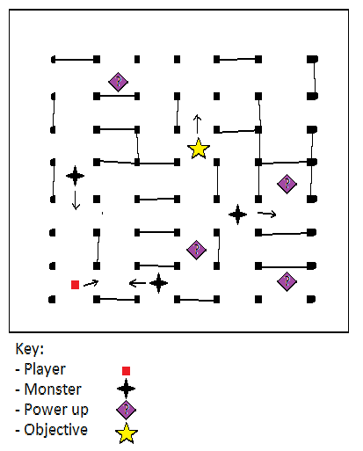
Gameplay/Premise
Objective: Catch the treasures before the time runs out
Obstacles:
Monsters that chase you
Continually changing maze
Time limit
Power ups (stretch goal)
Speed boost
Illumination boost
Protection from monsters
Gives you object to throw at monsters (physics)

Slide 3
Requirements - GameObjects
Types of Objects
Hero/Player
Enemies
Barriers (at least 10 at all times)
Collectibles
Collisions
Nothing can pass through barriers, but can ricochet
Collectibles are picked up with collision
Power ups could help hero fight back enemy through some collision

Slide 4
Requirements - GameObjects
Chasing
Enemy will chase hero, trying to catch them
Chases until far enough away
Particle System
When colliding with collectables, cloud of particles disperse
Exploding particles when fighting back enemy with power up

Slide 5
Requirements - Scenes
Splash Screen
Team logo will fade in before game starts, then show the start screen
Game Scene
Randomly changing maze with all objects, split into different views of map
Win/Loss Scene
Winning scene shows the hero animation/celebration, next to “You Won” text
Losing scene shows the enemy catching hero next to “Game Over” text
Both scenes will have a “Quit” and “Try Again” option

Slide 6
Requirements - Physics
←Collectable
←Chaser/Monster
←Player
Physics
Walls
Player & Chasers
Certain Power Ups
Interpolation & ShakePosition
Interpolate movement
Fluid movement following player, and between waypoints
Cameras
Use ShakePosition as feedback
When a player crashes into a wall
When receiving the collectable
←Wall
Notes:
Note: We will probably have more than four lights, and therefore need

Slide 7
Requirements - UI
Canvas
Time: 23 seconds
TIP: Press WASD to move!
Help View
Items to Retrieve
3 Views (single player)
Main View
Minimap View
Objective/Help View
Lighting
Directional → Player Light
Point Light → Power Ups
Spotlight → Collectable (Changing Size & Color)
Normal Map → Chasers, Player & Walls
Main View
Minimap

Slide 8
Requirements - UI
Canvas
Time: 23 seconds
TIP: Press WASD to move!
Player 1 View
TIP: Avoid the chasers!
4 Views (split-screen multiplayer)
Main Views (player 1 & player 2)
Minimap View
Objective/Help View
Lighting
Directional → Player Light
Point Light → Power Ups
Spotlight → Collectable (Changing Size & Color)
Normal Map → Chasers, Player & Walls
Help View
Items to Retrieve
Player 2 View
Minimap

Slide 9
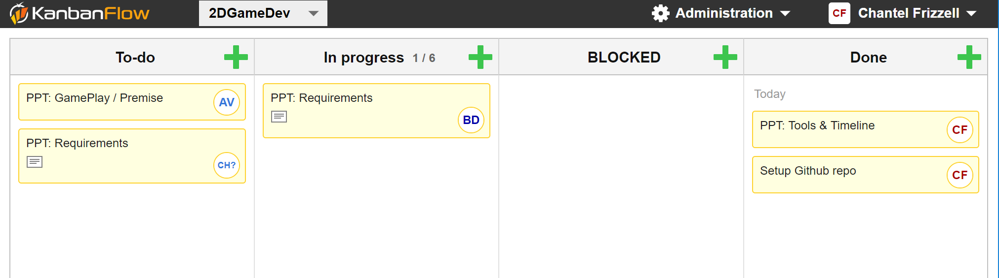
Tools & Timeline : KanbanFlow
Assign tasks
Track progress
Be aware of impediments

Slide 10
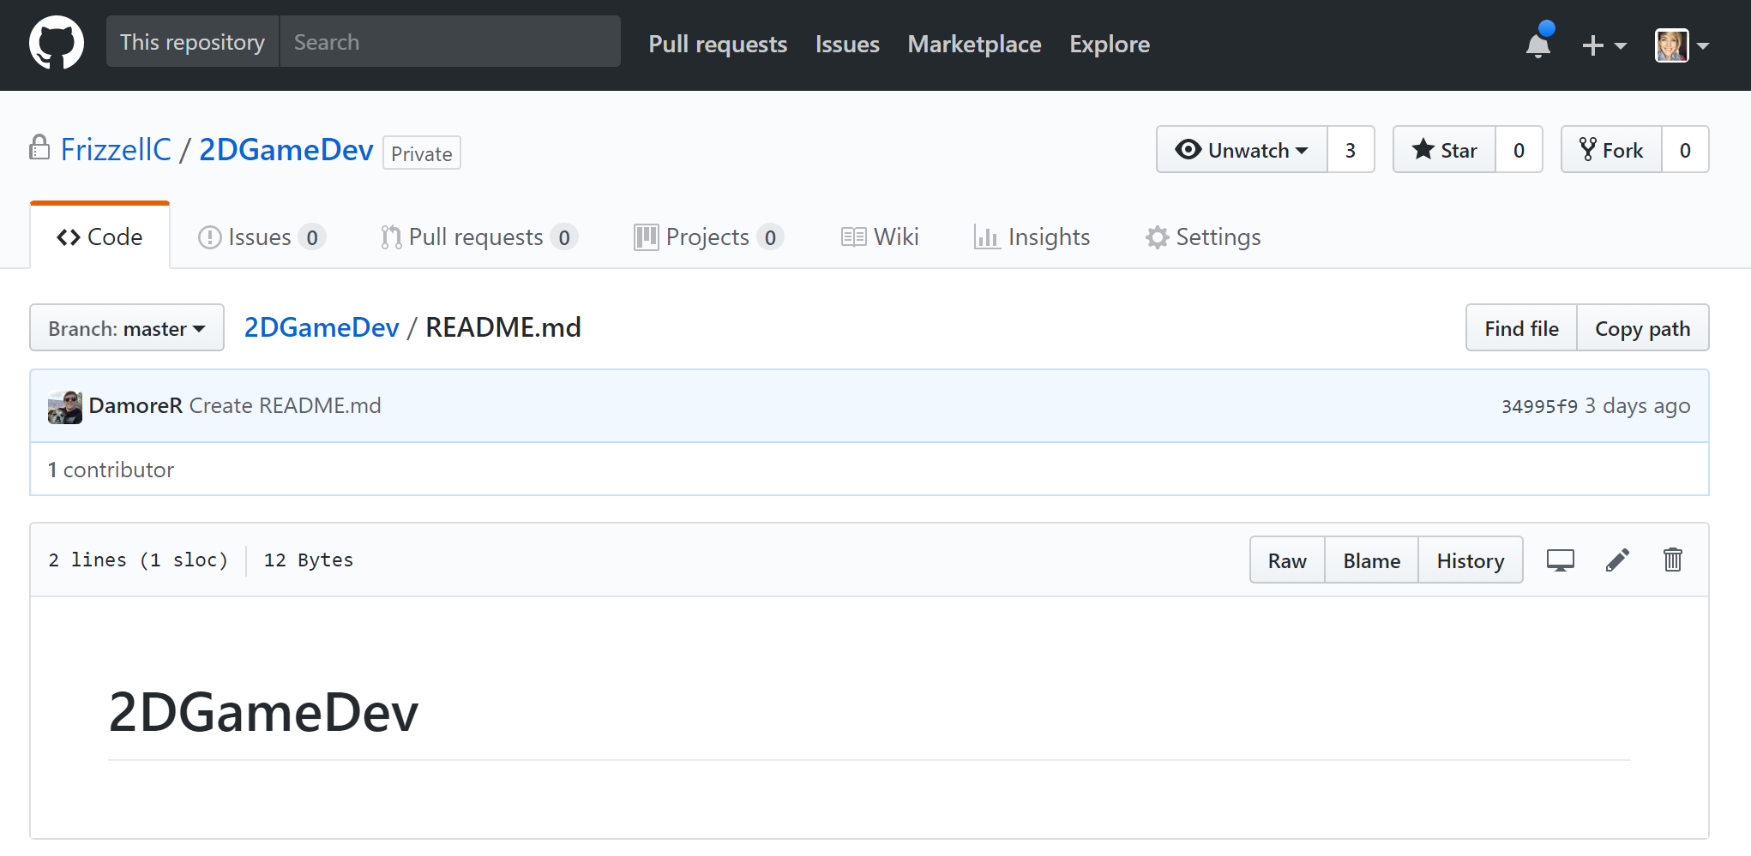
Tools & Timeline: Github

Slide 11
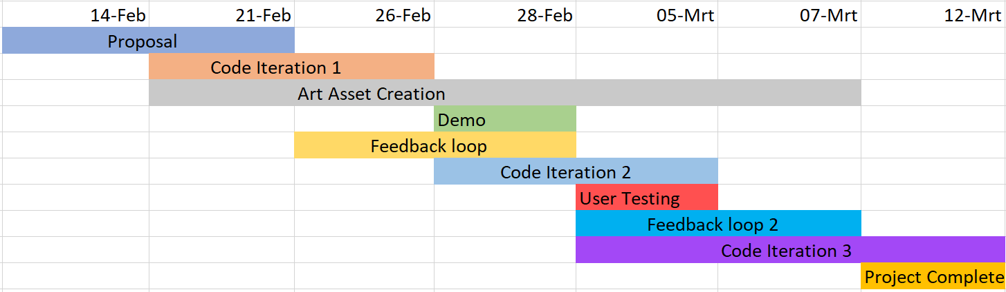
Tools & Timeline: Schedule

Slide 12
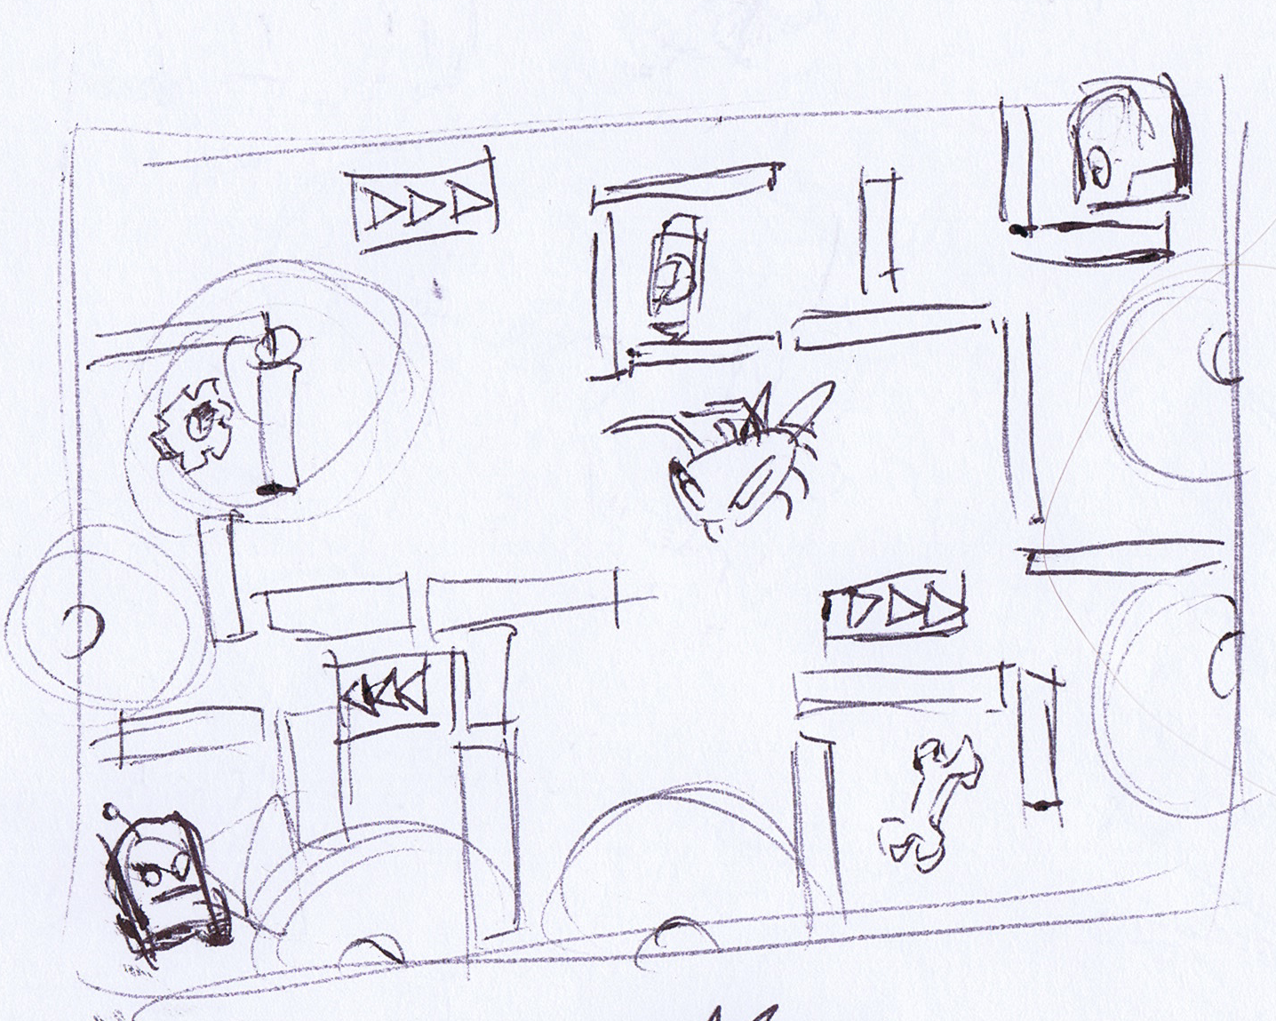
Questions?

Slide 13
